Slide 2


Slide 3
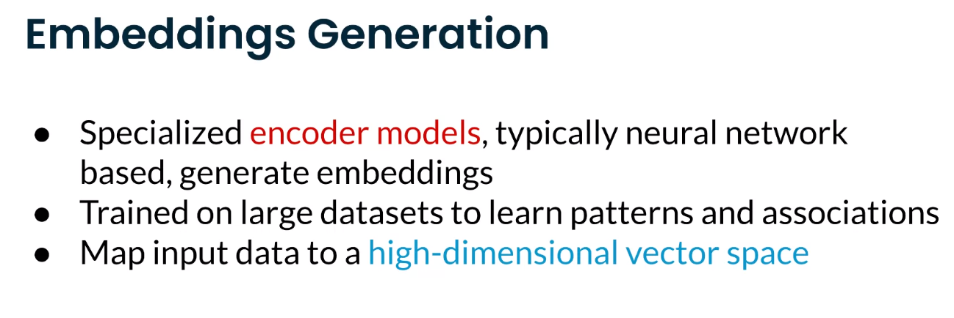

Slide 4


Slide 5
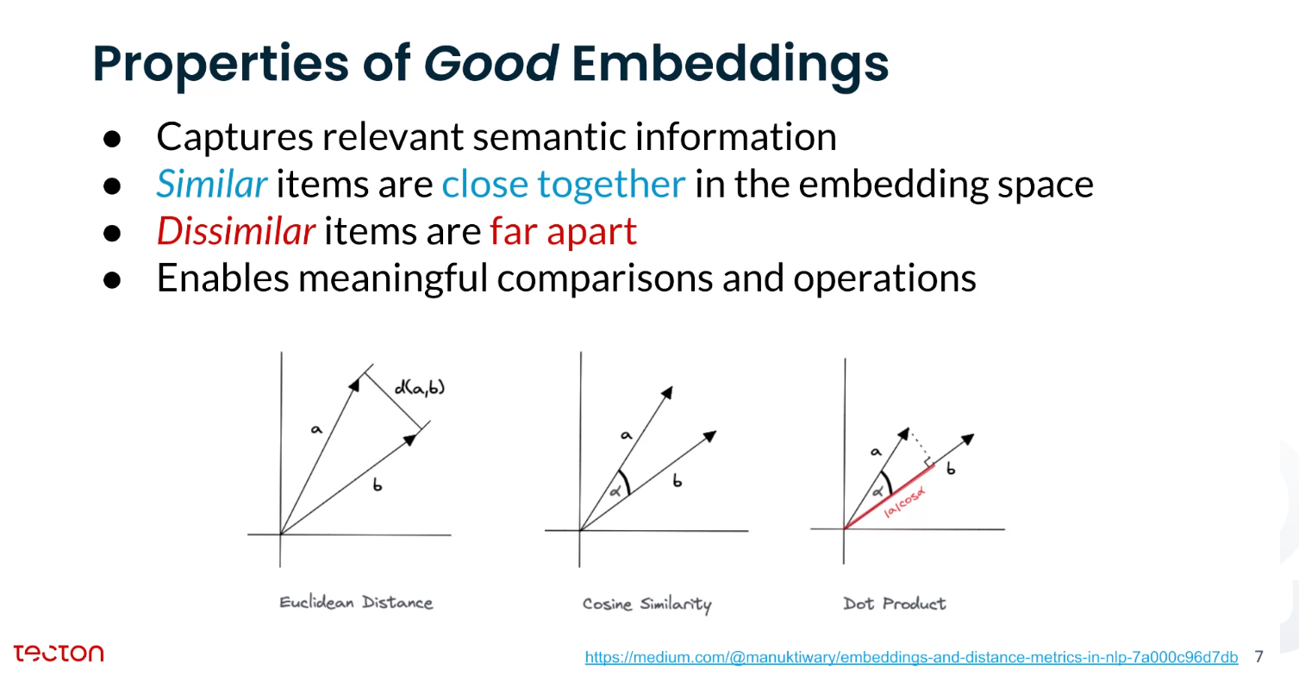

Slide 6
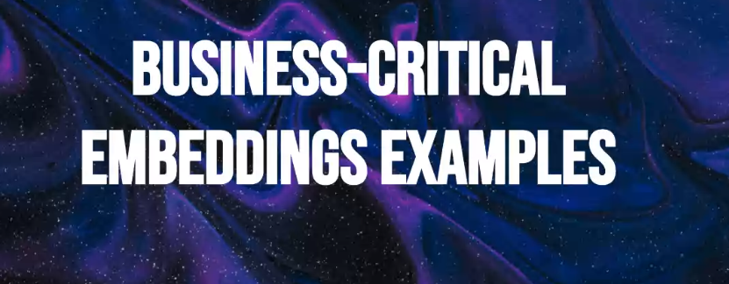

Slide 7
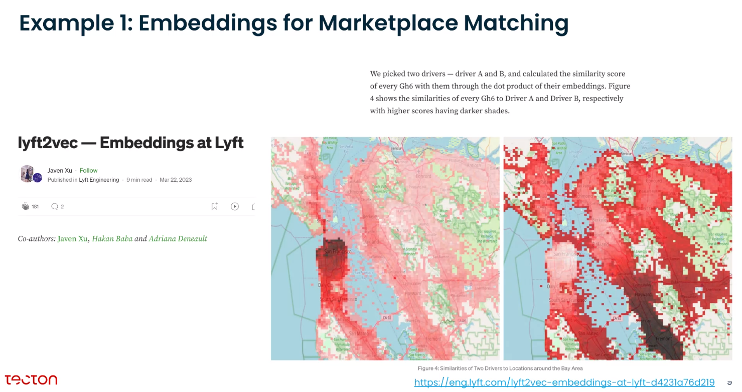
time of day, location, direction of move (shift), how many drives in a week, 100 different items
Gh6 (region), drop off and pick up locations.

Slide 8
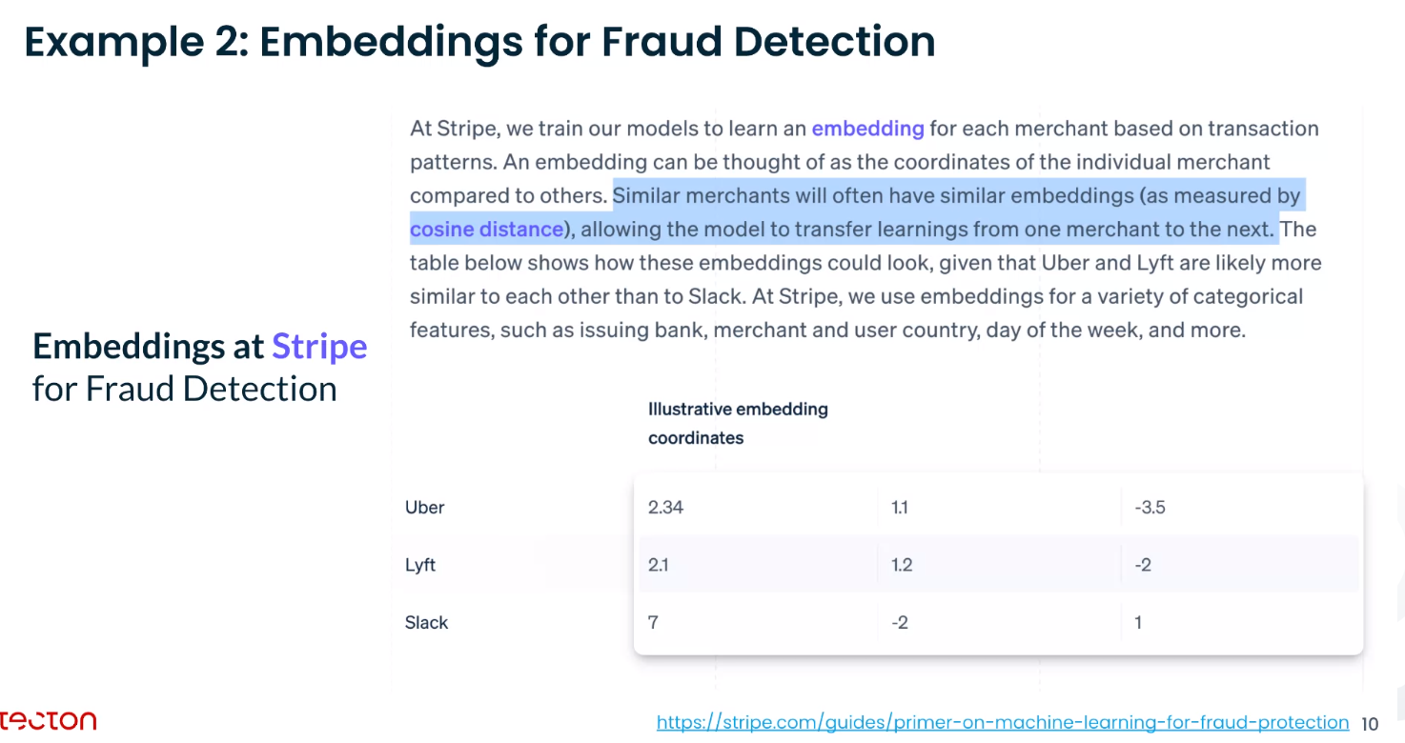

Slide 9
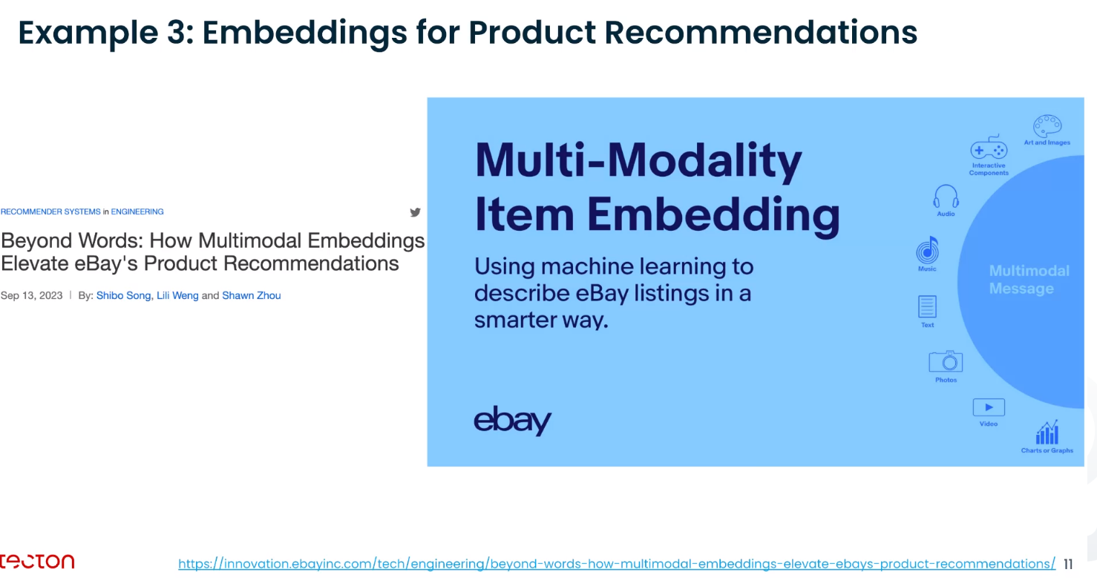

Slide 10
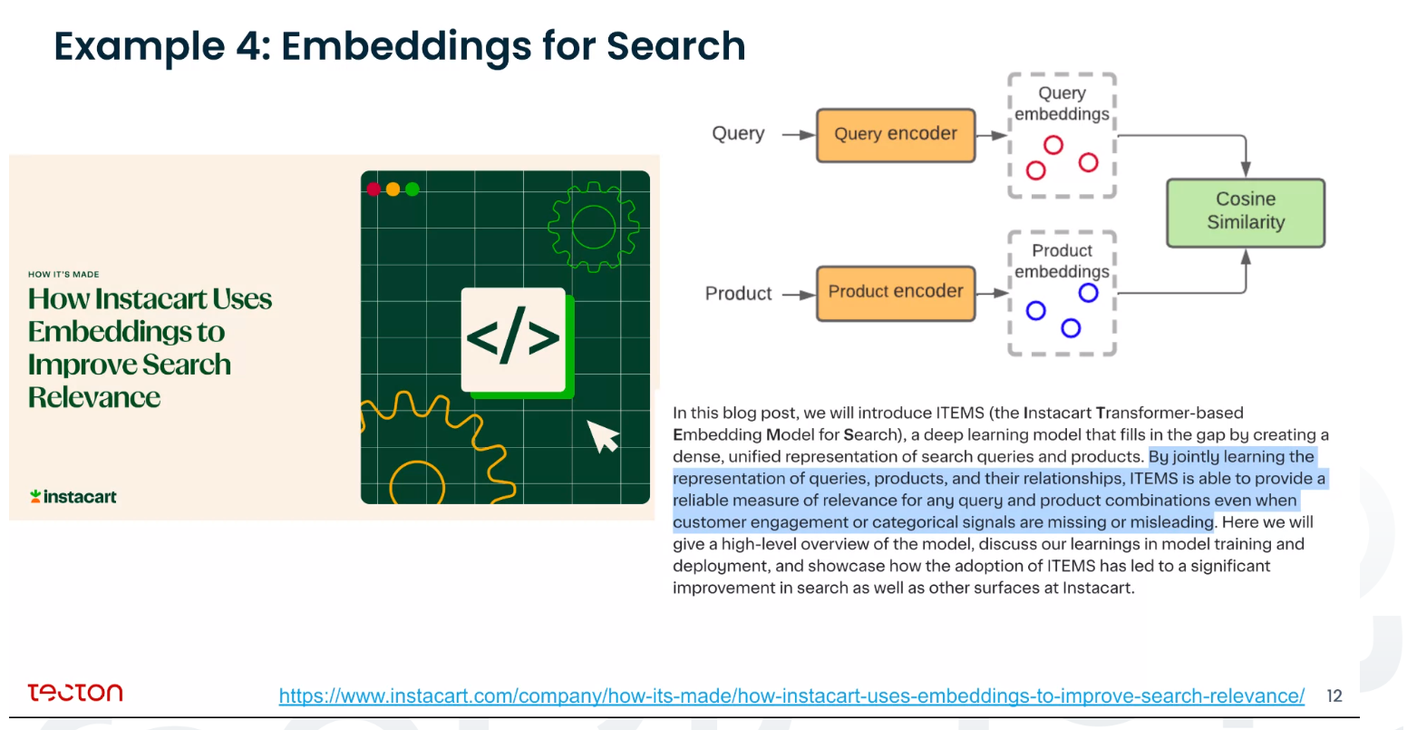

Slide 11
What is the intuition behind OS embedding models being better than the commercial providers?
EK
Eric Kerecz12:20 PM
Q/A
Q: What is the intuition behind OS embedding models being better than the commercial providers?
Ans: Afraz, the usefulness of embeddings is context-dependent. In one use-case, a business was embedding fairly complex json representations of invoices to avoid heavy DE work. Most of these invoices have structure, and are highly similar beyond maybe a handful of numbers. Fine-tuning an OS model to your data will likely get you better performance in this case. Using a hastily built index from top-level info outperformed embeddings in that case.

Slide 12
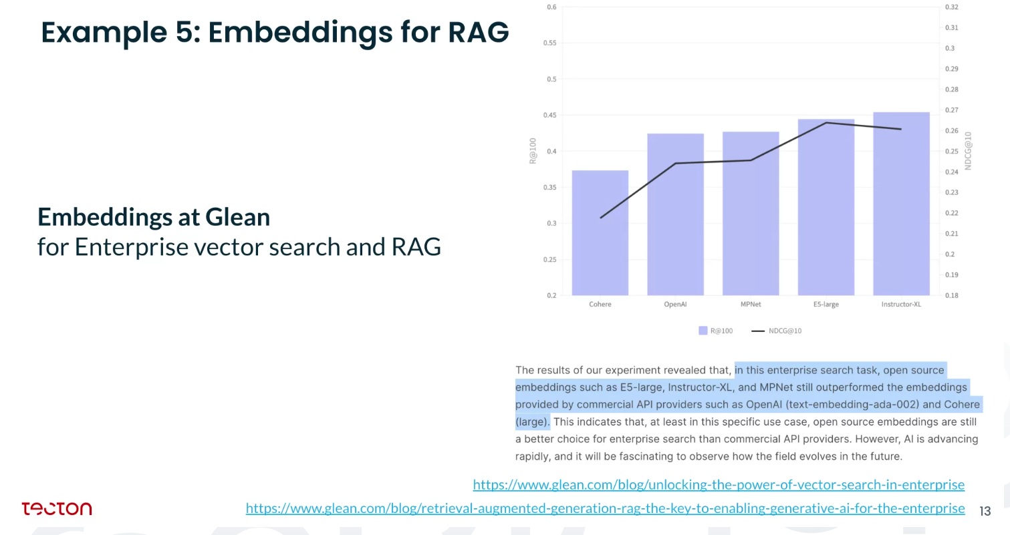

Slide 13
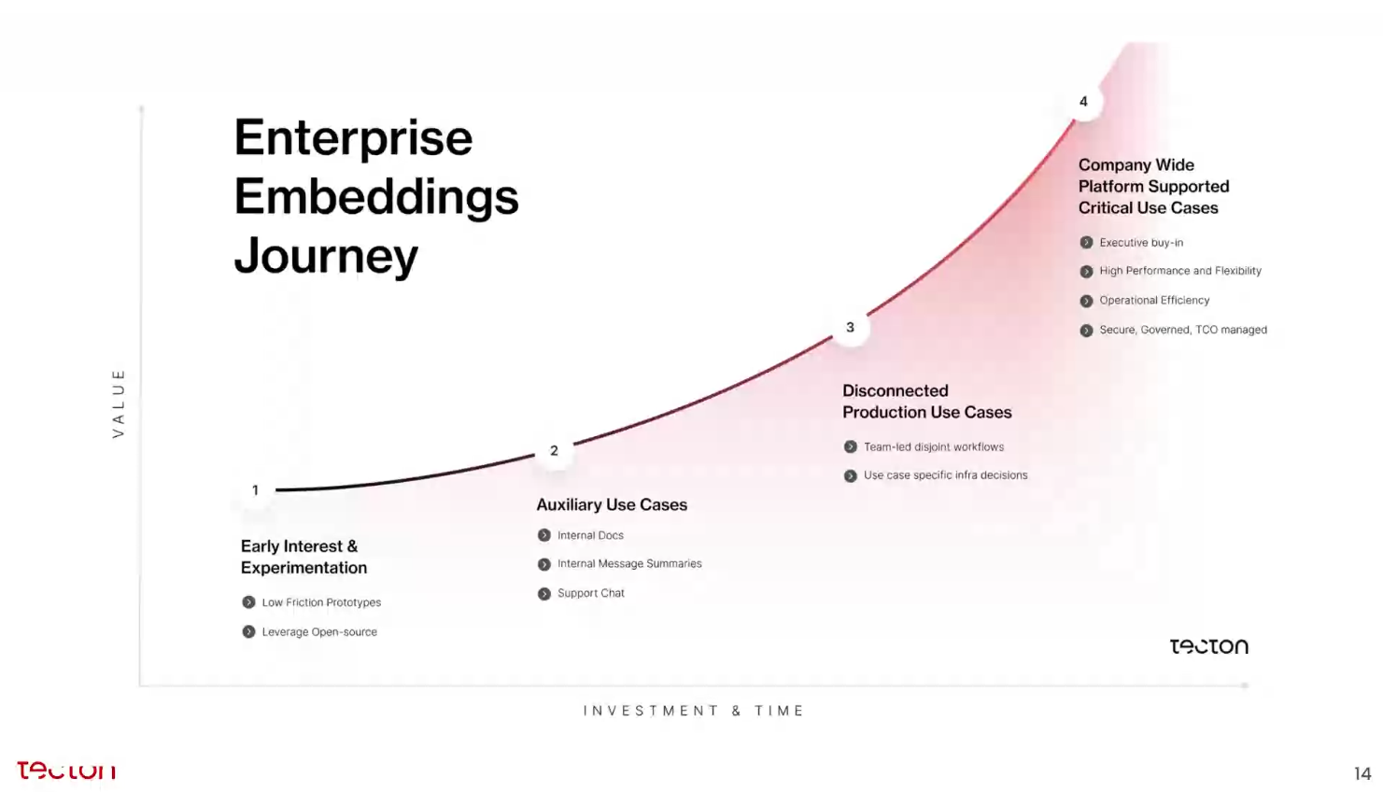
Build high performance and flexible system
Leading tech companies. More close to steps 3 and 4
When diff team, fig out some business
Usecases and build for that
How to generate embeddings
How to use them
Internal documentations
How to develop things
HR queries and other support queries
Many companies use step 1 to
Get a product prototype

Slide 14
Step 3 and 4 the rest of conversation

Slide 15
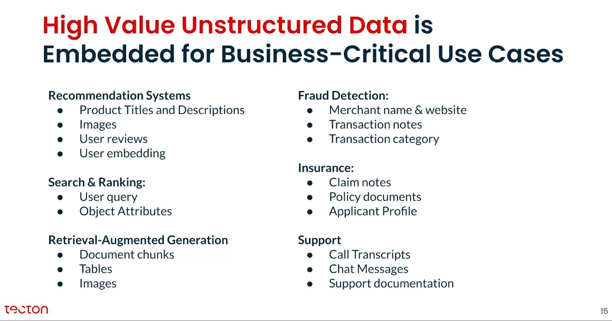

Slide 16
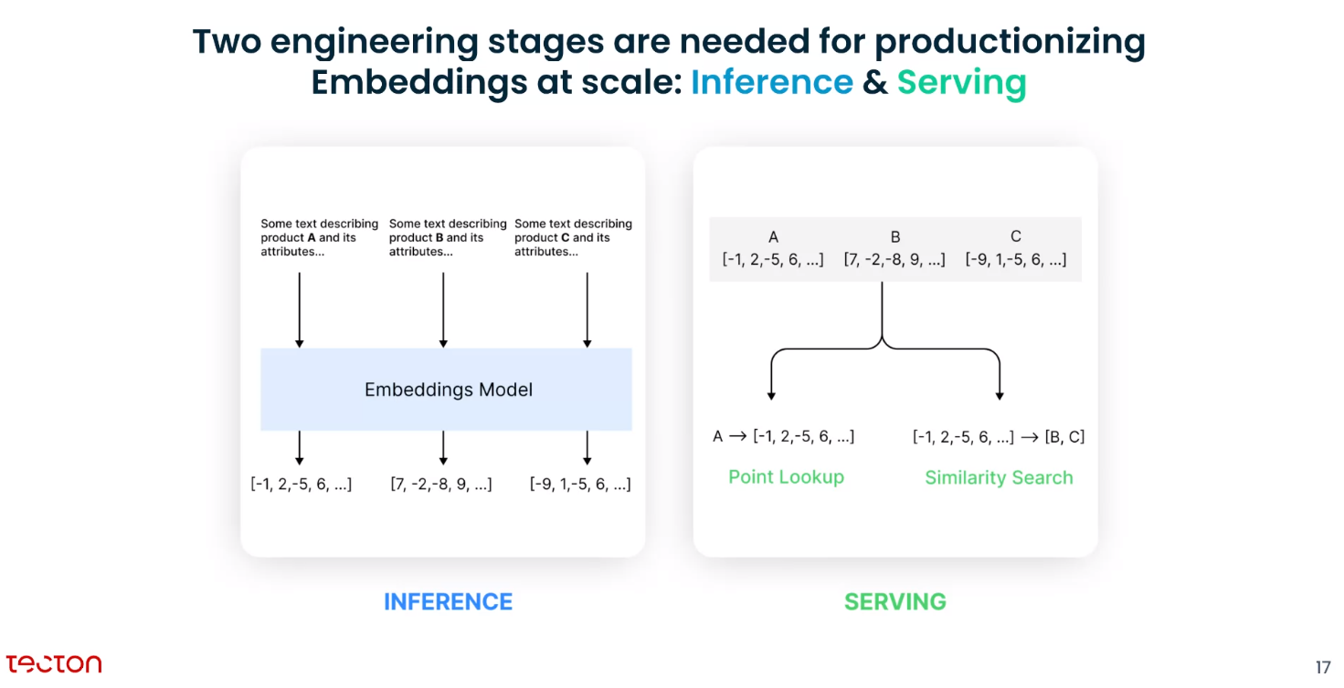

Slide 17
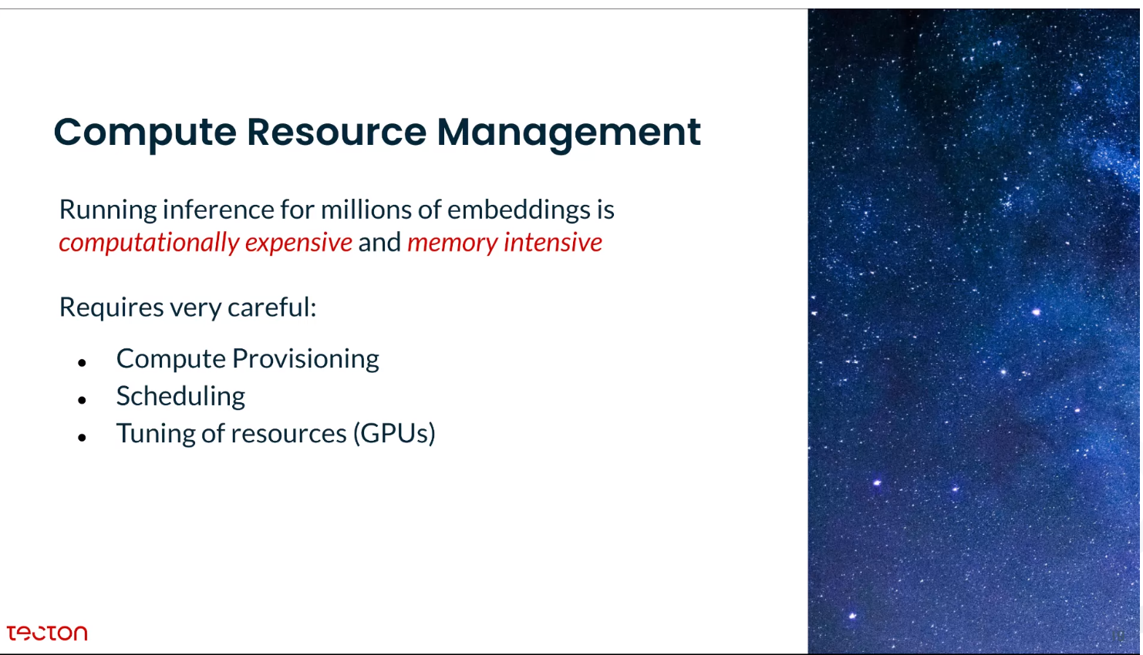

Slide 18
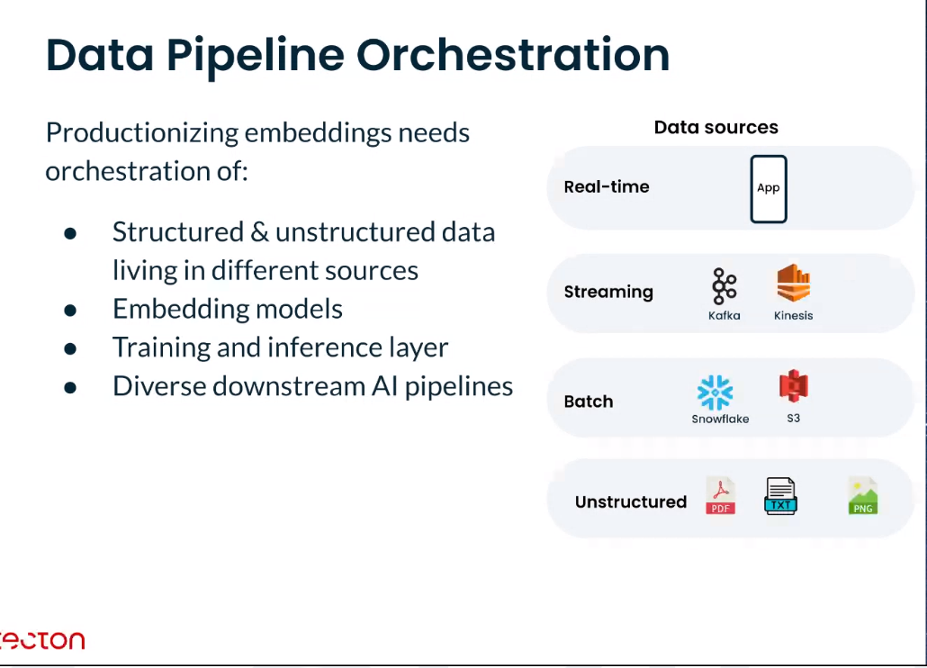
Notes:
You data from many different sources. Steaming data from kafka, warehouse a

Slide 19
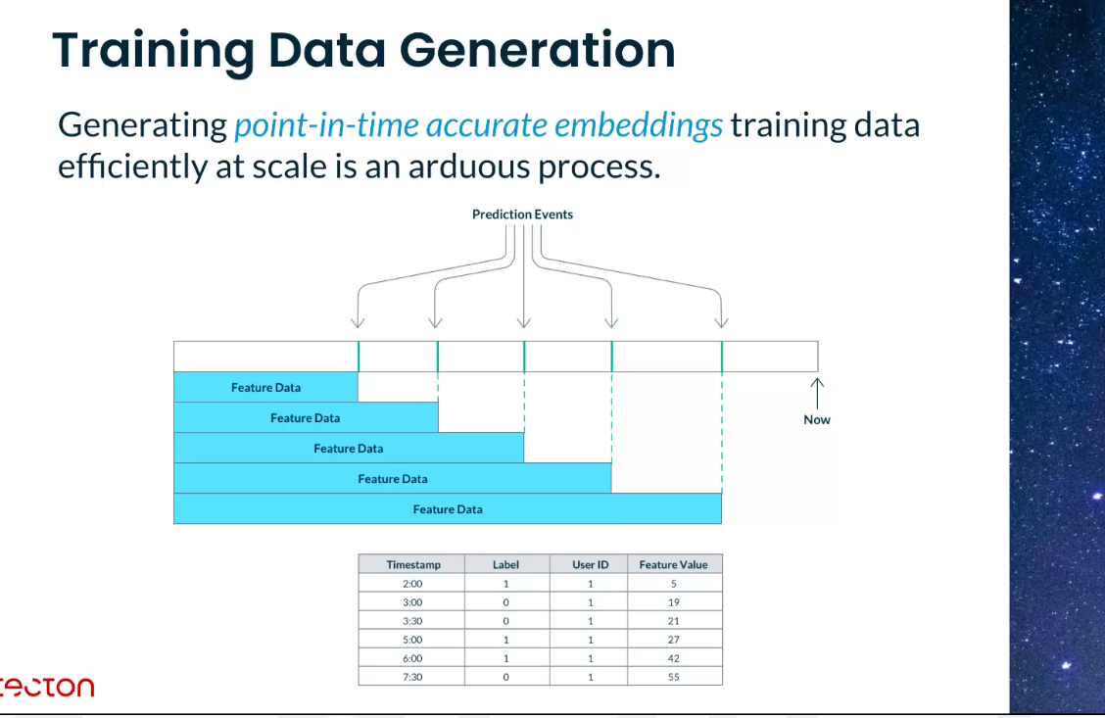

Slide 20
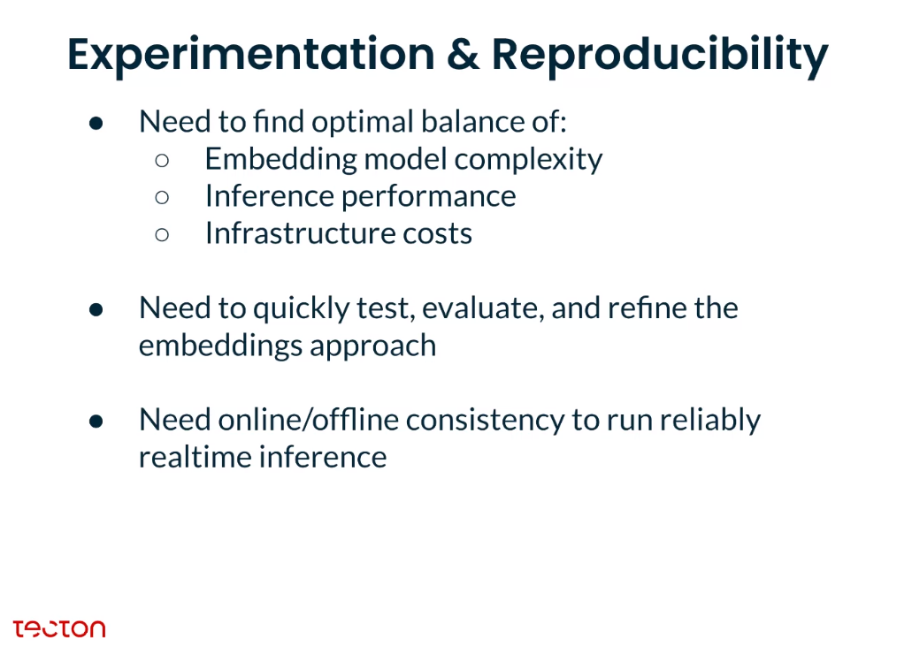
Online/offline consistency means what?

Slide 21
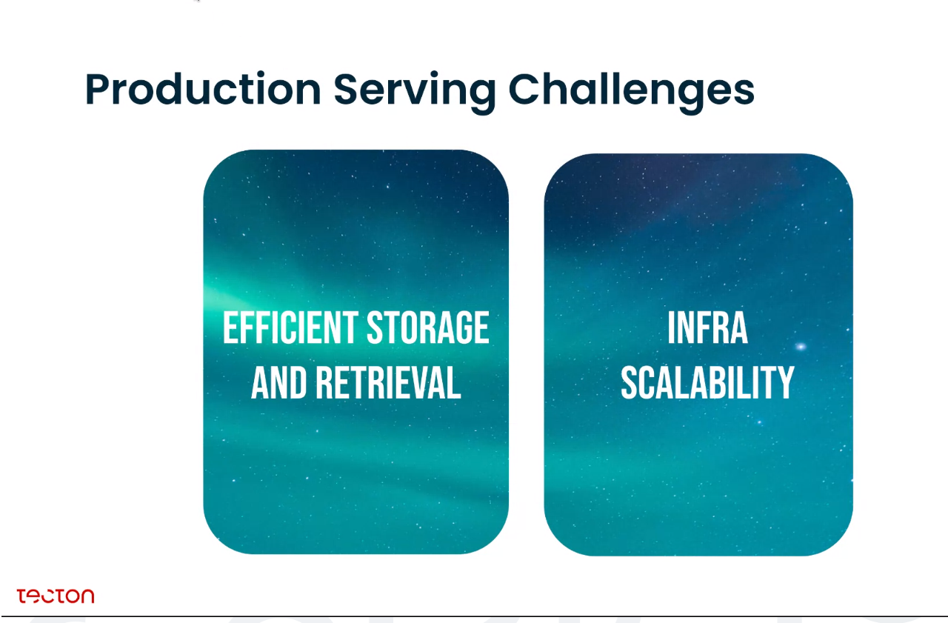

Slide 22
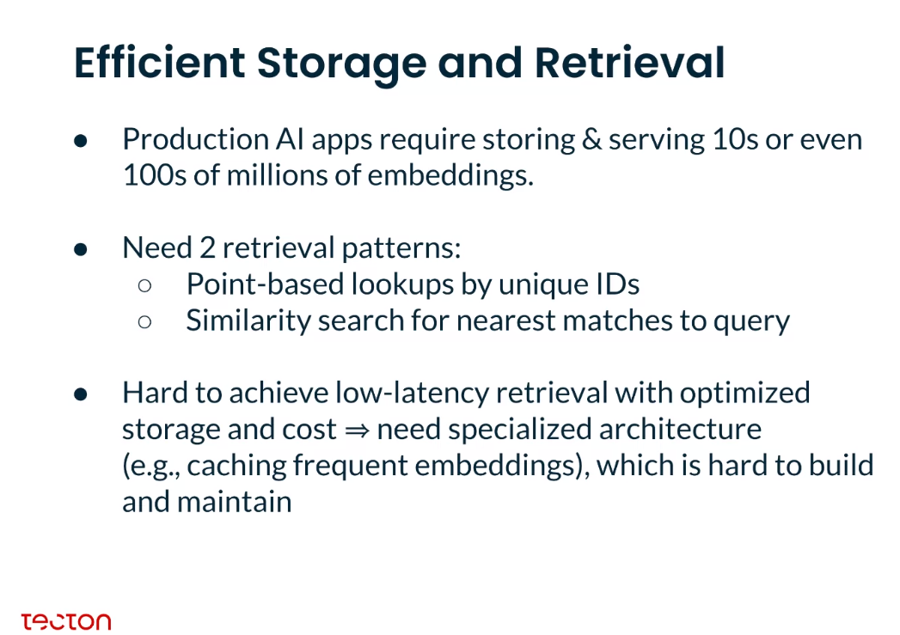

Slide 23
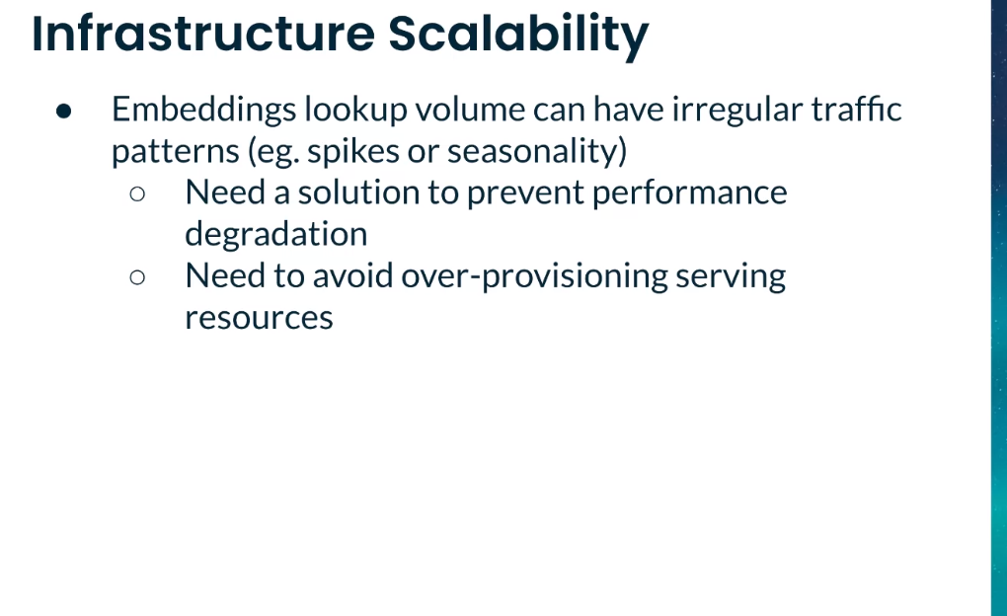
Like blackfriday

Slide 24
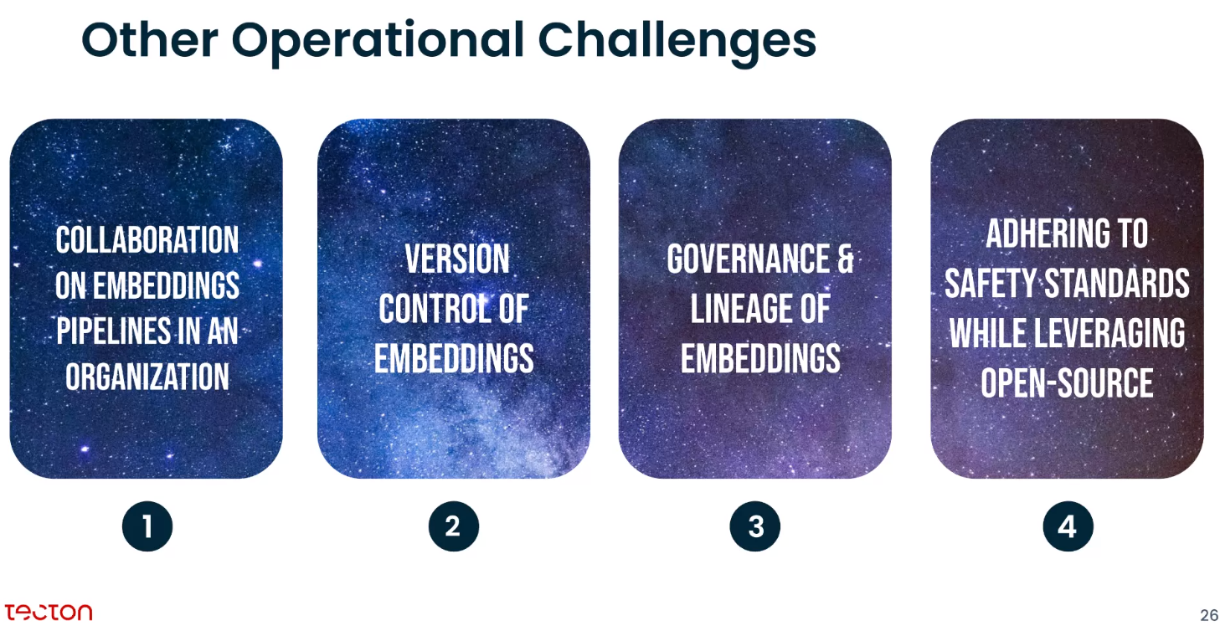

Slide 25
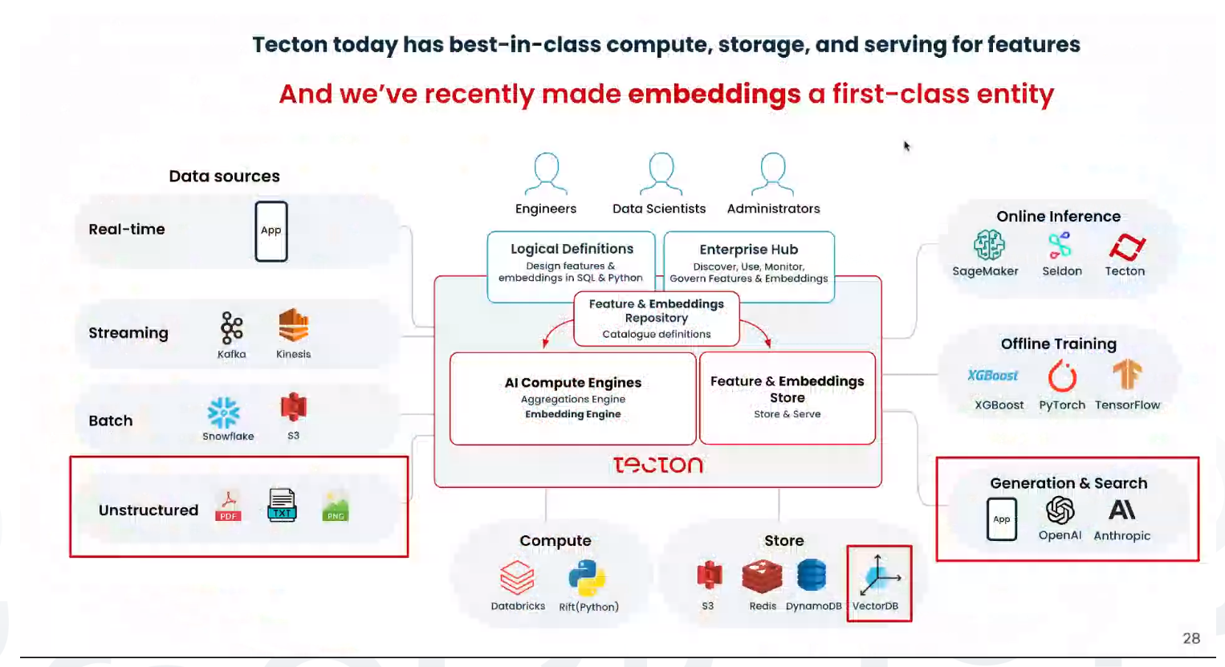

Slide 26
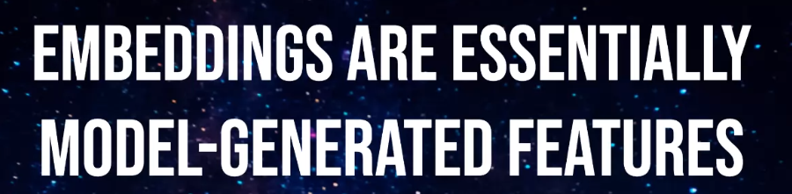
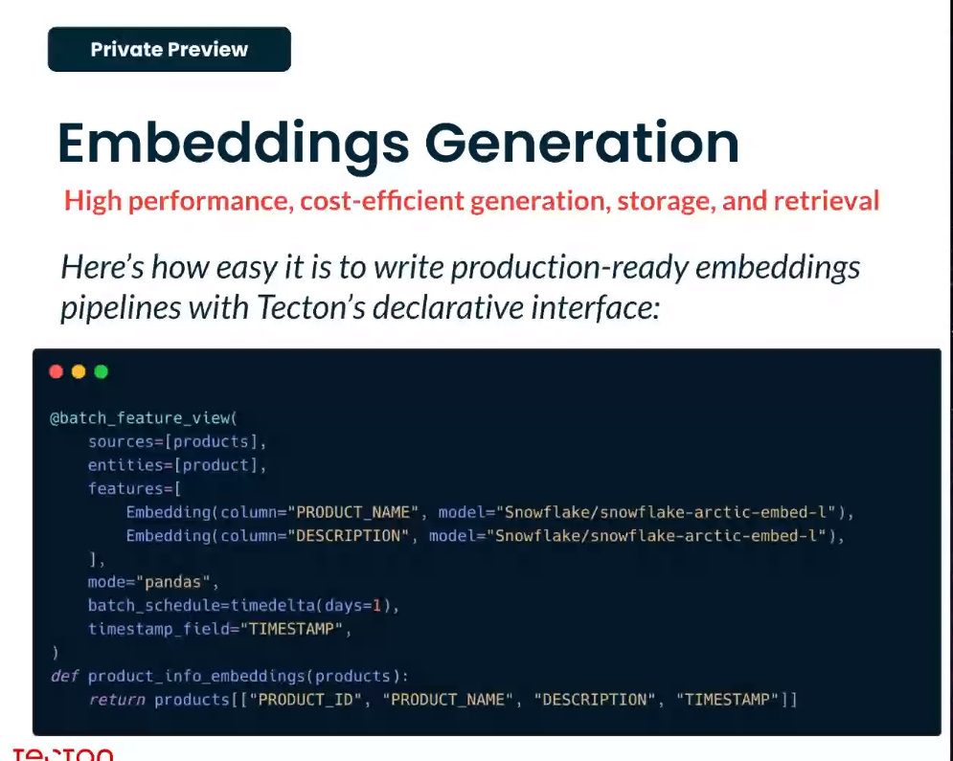
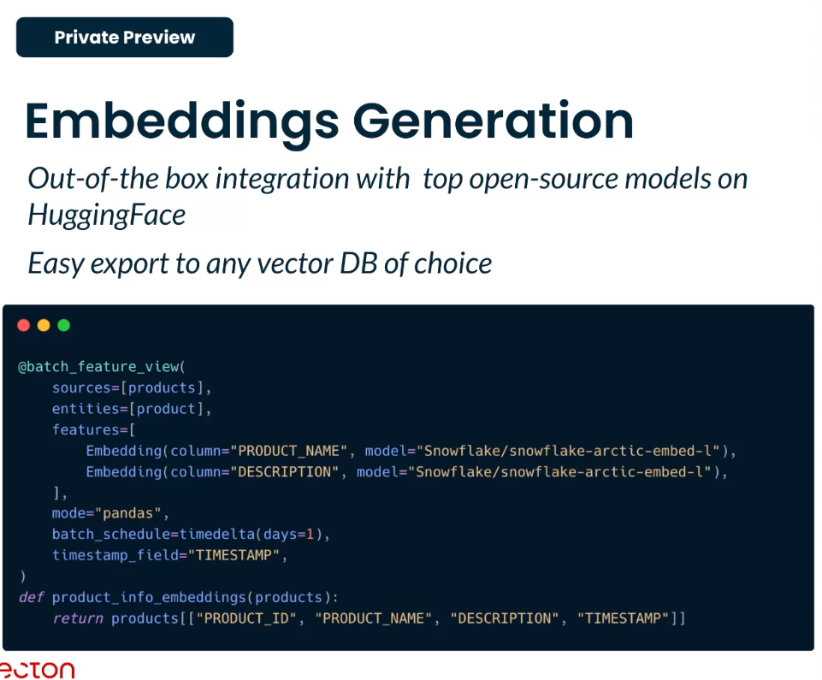

Slide 27
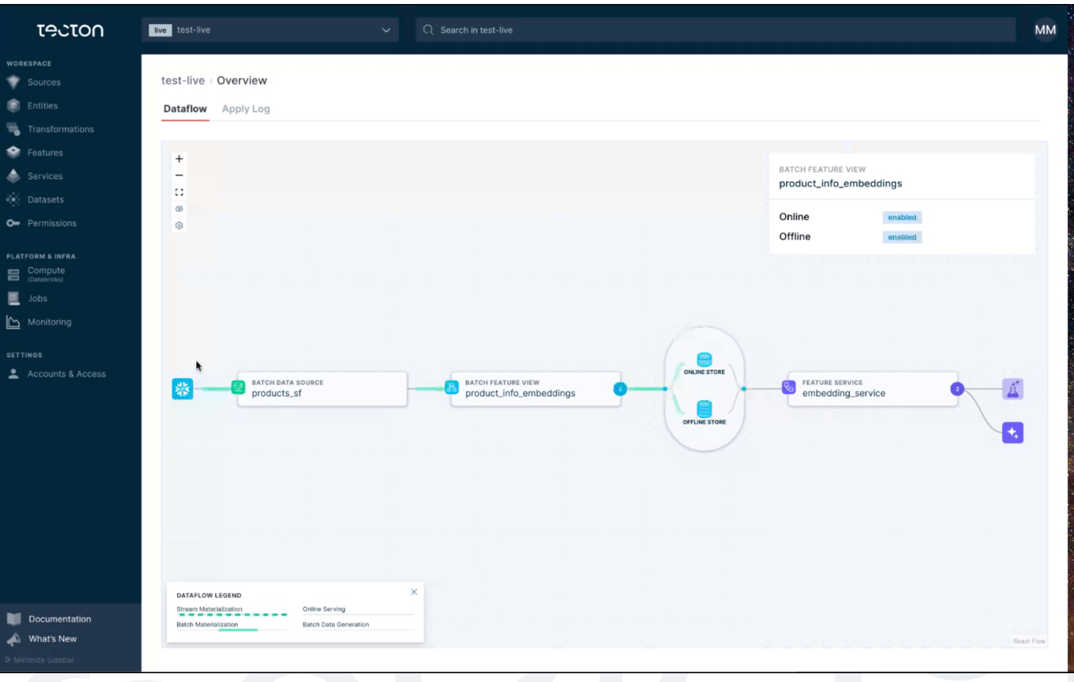
training
inference

Slide 28
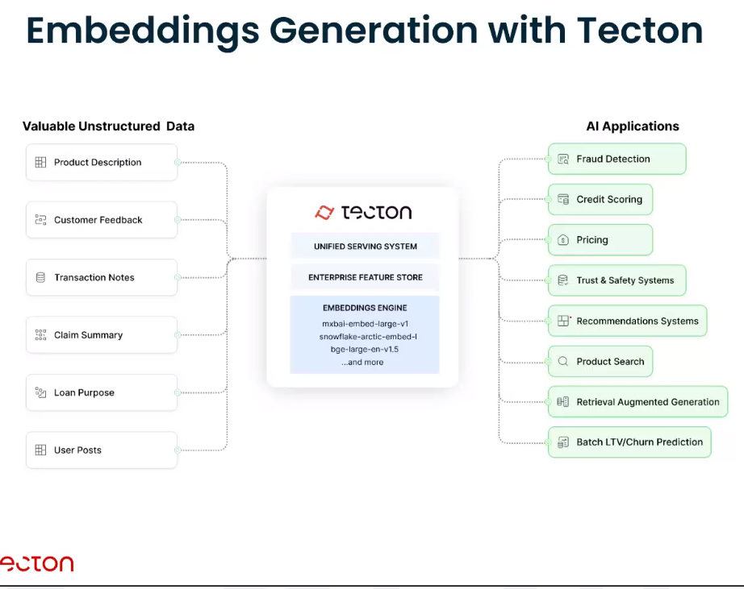

Slide 29
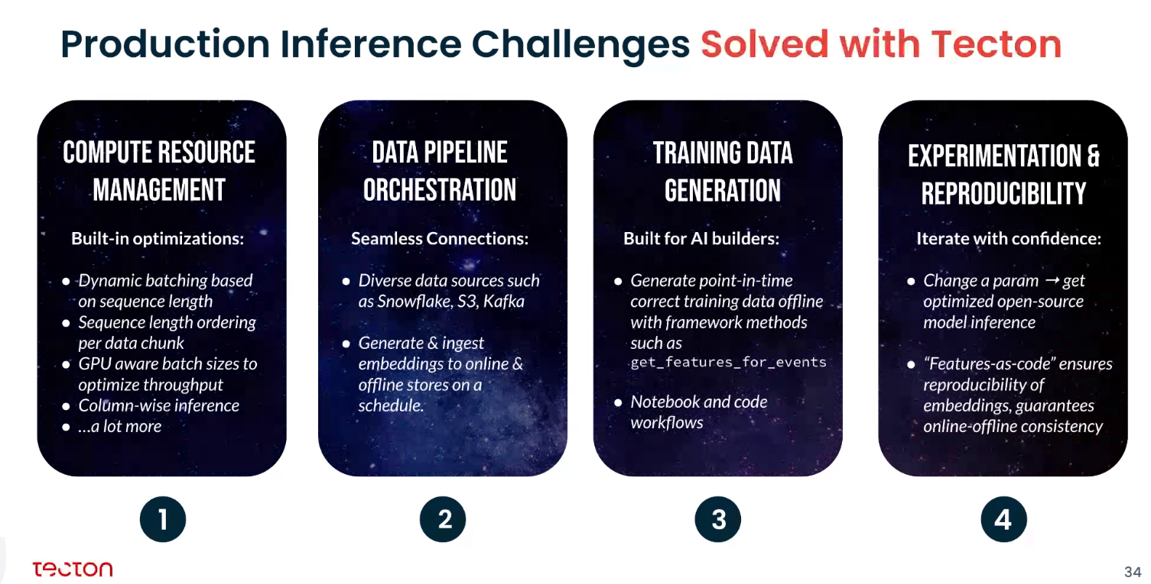

Slide 30
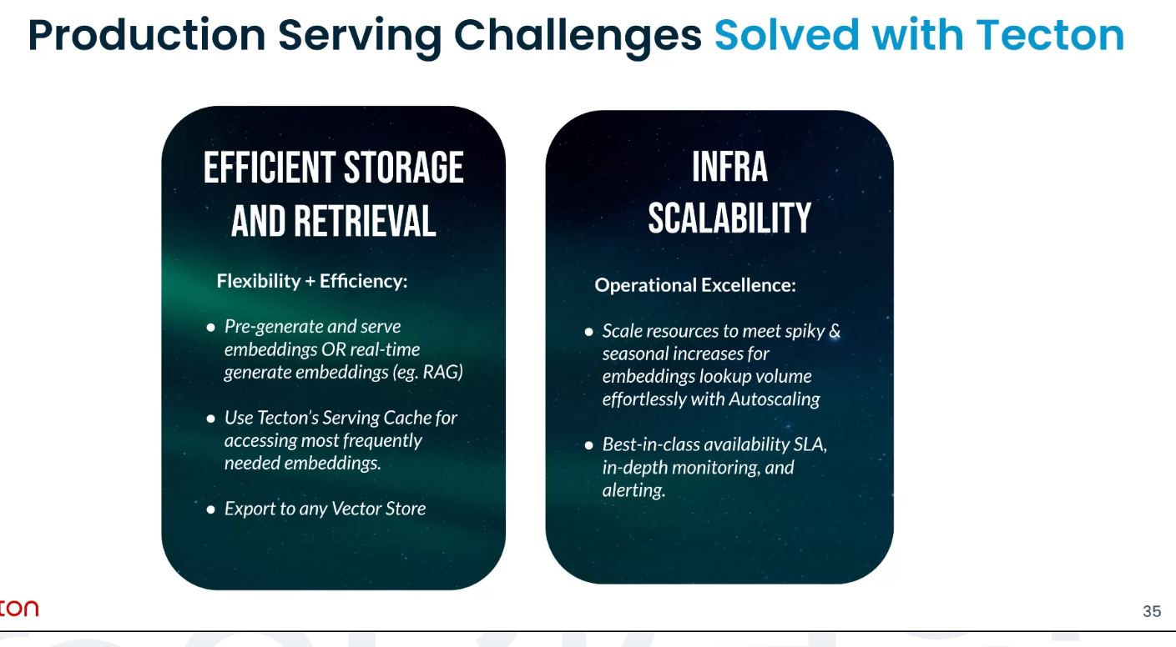

Slide 31
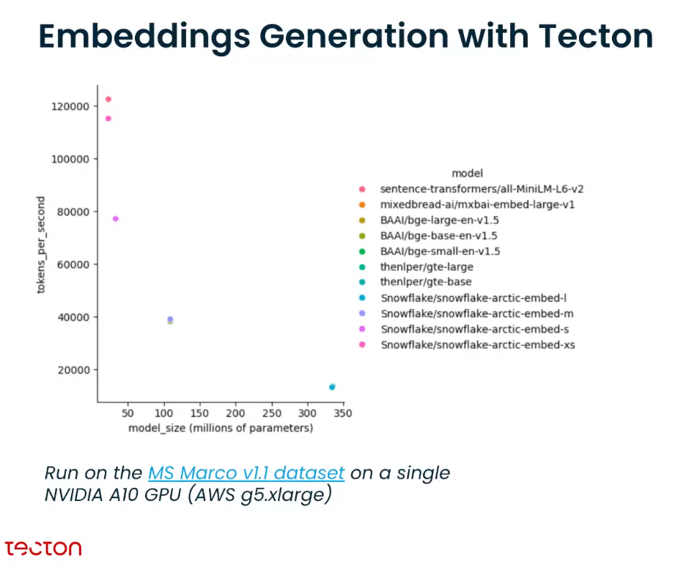

Slide 32
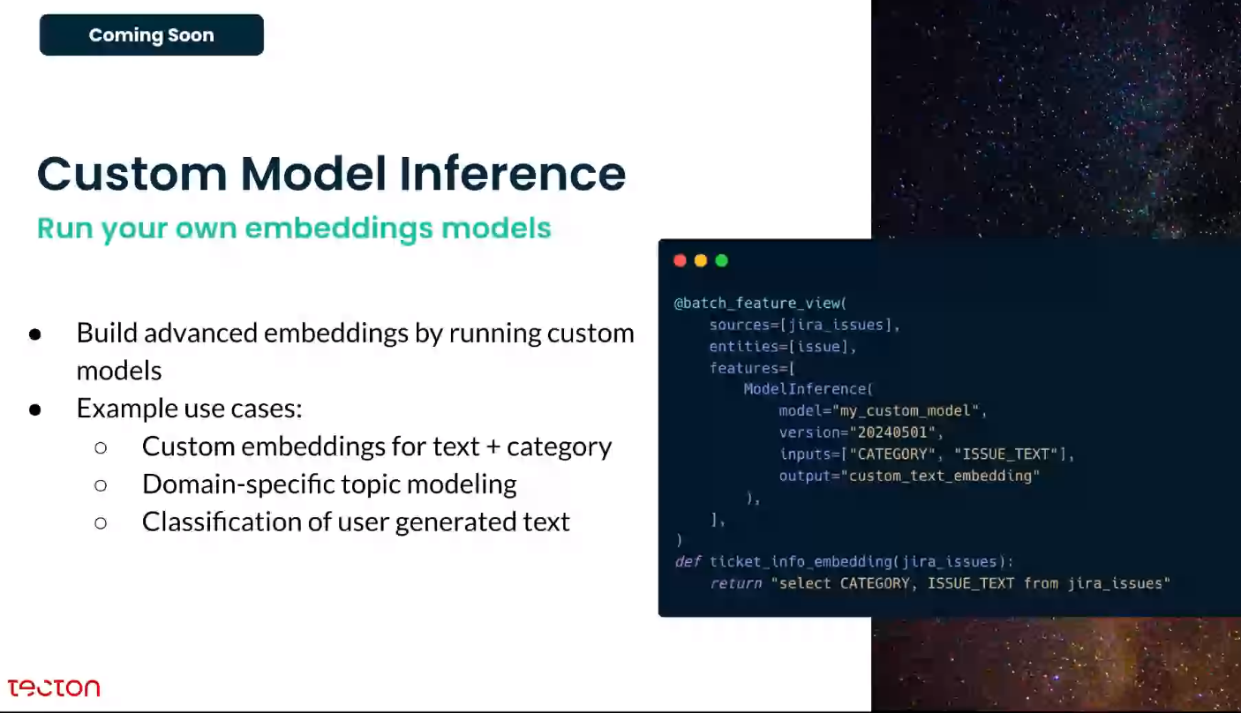
Like embedding for health care

Slide 33
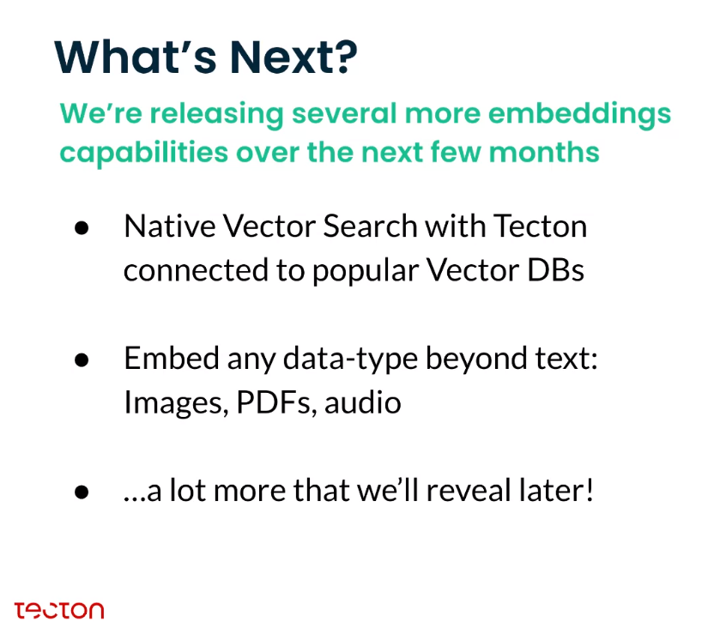

Slide 34
Email: Mihir@tecton.com

